Slide 1
Convolutional Neural Network

Slide 2
Content
Derivation
Definition
Application
Implementation
Extension

Slide 3
Content
Derivation
Term expand
Digital image process
Edge detection
SIFT features
Important properties
Local invariance
Hierarchical structure
Definition
Convolutional Layer (with padding)
Pooling Layer
Active function - Relu
Application
Image
Voice
Text
Implementation
Expand / Unexpand method
Cuda-convnet
Extension
Network in Network
Saliency base improve
Colinear Convolutional Layer

Slide 4
Deviation – Term Expansion
Activation
Error
Feed Forward
Back Propagation
Neural Network
Layer/Connection
Active Function
Full-Conn Layer
Conv Layer
Pooling Layer
Sigmoid
Tanh
Rectify

Slide 5
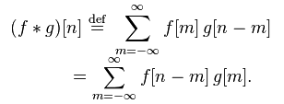

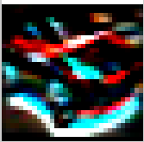

Deviation – Term Expansion
Signal
Math
Convolution
Image
Edge
Blur
-1
-2
-1
4
7
4
0
0
0
7
10
7
1
2
1
4
7
4

Slide 6
Deviation – Edge detection

Slide 7
Deviation – SIFT Features

Slide 8
Deviation – Important properties

Slide 9
Definition – Convolutional Layer

Slide 10
Definition – Pooling Layer

Slide 11
Definition – Active Function

Slide 12
Application – Image

Slide 13
Application – Voice & Text

Slide 14
Implementation – expand/unexpand

Slide 15
Implementation – duda-convnet

Slide 16
Extension – Network in Network

Slide 17
Extension – Parameterize CNN

Slide 18
Extension – Colinear CNN

Slide 19
Q & A
Thanks!

